Slide 1

TRAVEL PLANNER AGENT
IBM GOVERNMENT INTERNSHIP 2025 PROJECT-1
AI-based Trip Planning Chatbot on IBM Cloud
Presented By:
SAKSHAM SAXENA
VIT BHOPAL UNIVERSITY - B.TECH CSE
Technology Used: - IBM Cloud, Watson Assistant

Slide 2
OUTLINE
A conversational chatbot built using IBM Watson Assistant that interacts with users to plan a trip by asking key questions like destination, budget, dates, and preferences, and provides a custom travel itinerary.
Problem Statement
Proposed System/Solution
System Development Approach
Algorithm & Deployment
Result (Output Images)
Conclusion
Future Scope
References

Slide 3
PROBLEM STATEMENT
Example: Travelers often find it difficult and time-consuming to plan trips — from choosing destinations to managing budgets. The need for a quick and intelligent virtual assistant that can suggest a trip plan is growing. This project aims to solve that by building an AI agent that can interactively plan travel itineraries through simple conversations.

Slide 4
PROPOSED SOLUTION
We have developed a chatbot called Travel Planner Agent using IBM Watson Assistant that: -
Takes user input for destination, budget, travel date, and preferences.
Generates a customized travel itinerary.
Allows users to restart the planning process.
Uses conditional logic and context variables.
Provides an intuitive, user-friendly experience.

Slide 5
SYSTEM APPROACH (TECHNOLOGY USED)
Components | Tools / Tech. Used
Chatbot Framework | IBM Watson Assistant
NLP + Logic Flow | Watson Dialog Skills
Deployment | IBM Cloud (Lite Plan)
Language Model | IBM Granite / Prebuilt Intents
Variables Handling | Context variables + logic jumps
Platform | Web interface (Watson Preview)

Slide 6
ALGORITHM & DEPLOYMENT
Algorithm:
Capture user input using free text or buttons
Store input into context variables (e.g., $destination, $travel_date)
Use conditional jumps to guide the conversation
Generate a static or templated travel itinerary
Ask user if they want to restart
If Yes → clear variables & restart
Deployment:
Hosted on IBM Watson Assistant
Chat preview available via IBM Cloud
Optional: Exported as .json for backup

Slide 7
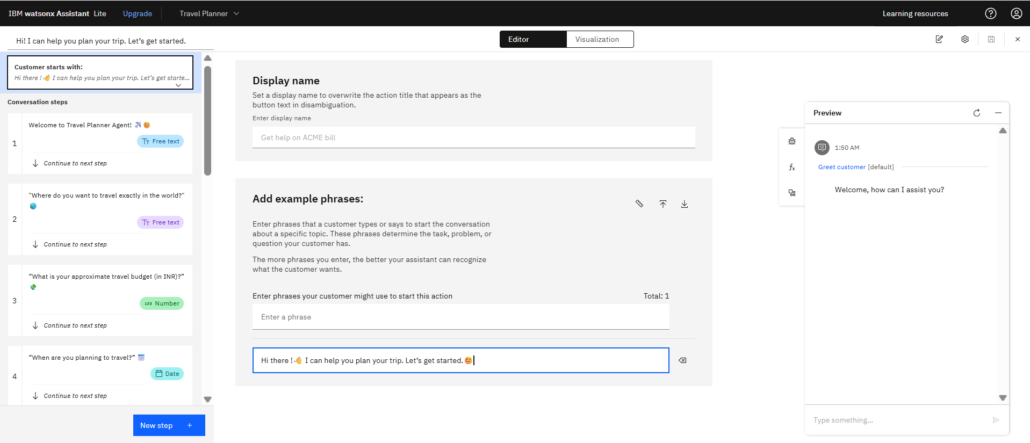
RESULTS
“Bot asking user for preferences and returning a personalized itinerary along with their previews.”
STEP-1 “Hi there !👋 I can help you plan your trip. Let’s get started.”😊

Slide 8
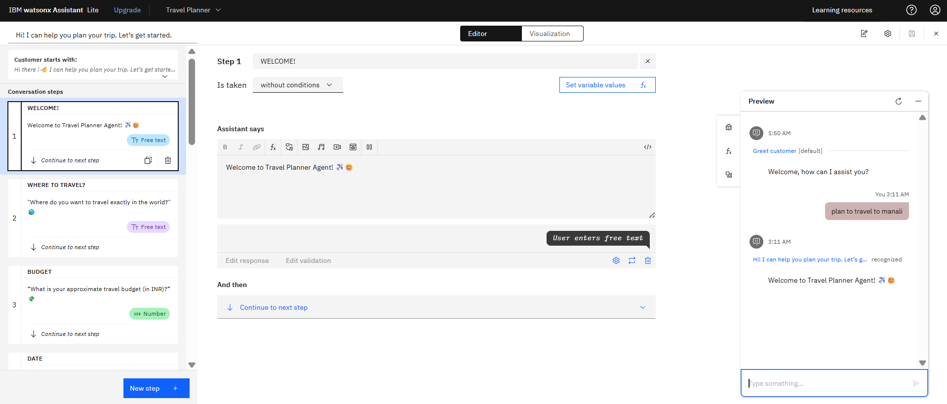
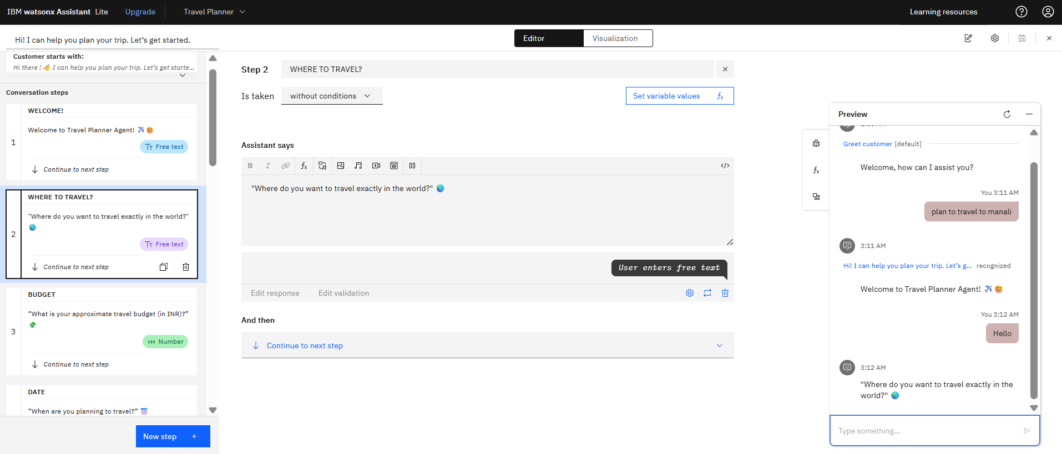
STEP-2 WELCOME “Welcome to Travel Planner Agent!” ✈️😊
STEP-3 "Where do you want to travel exactly in the world?" 🌏

Slide 9
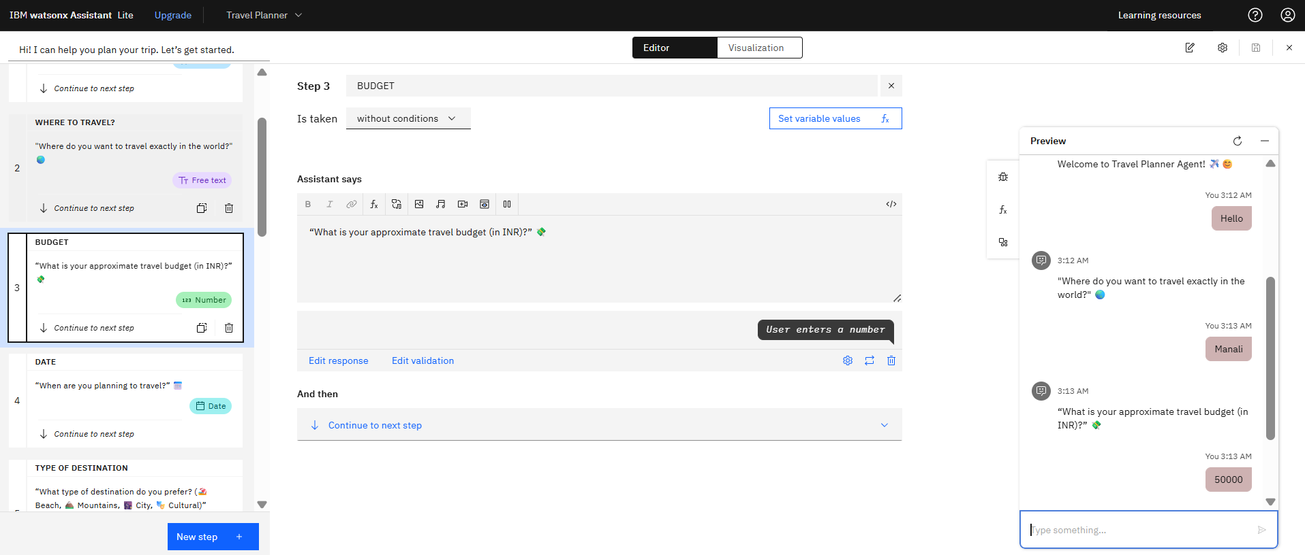
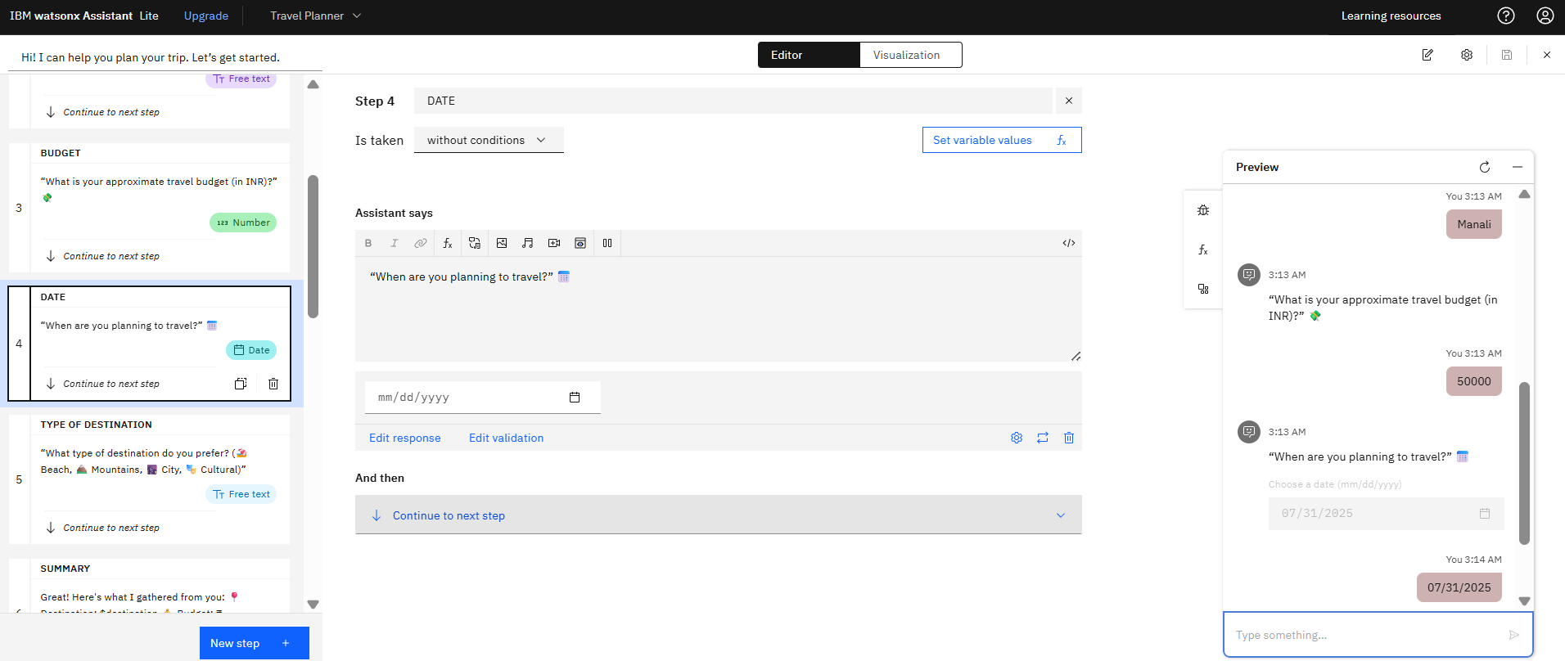
STEP-4 BUDGET “What is your approx. travel budget (in INR)?”💸
STEP-5 DATE “When are you planning to travel?” 📅

Slide 10
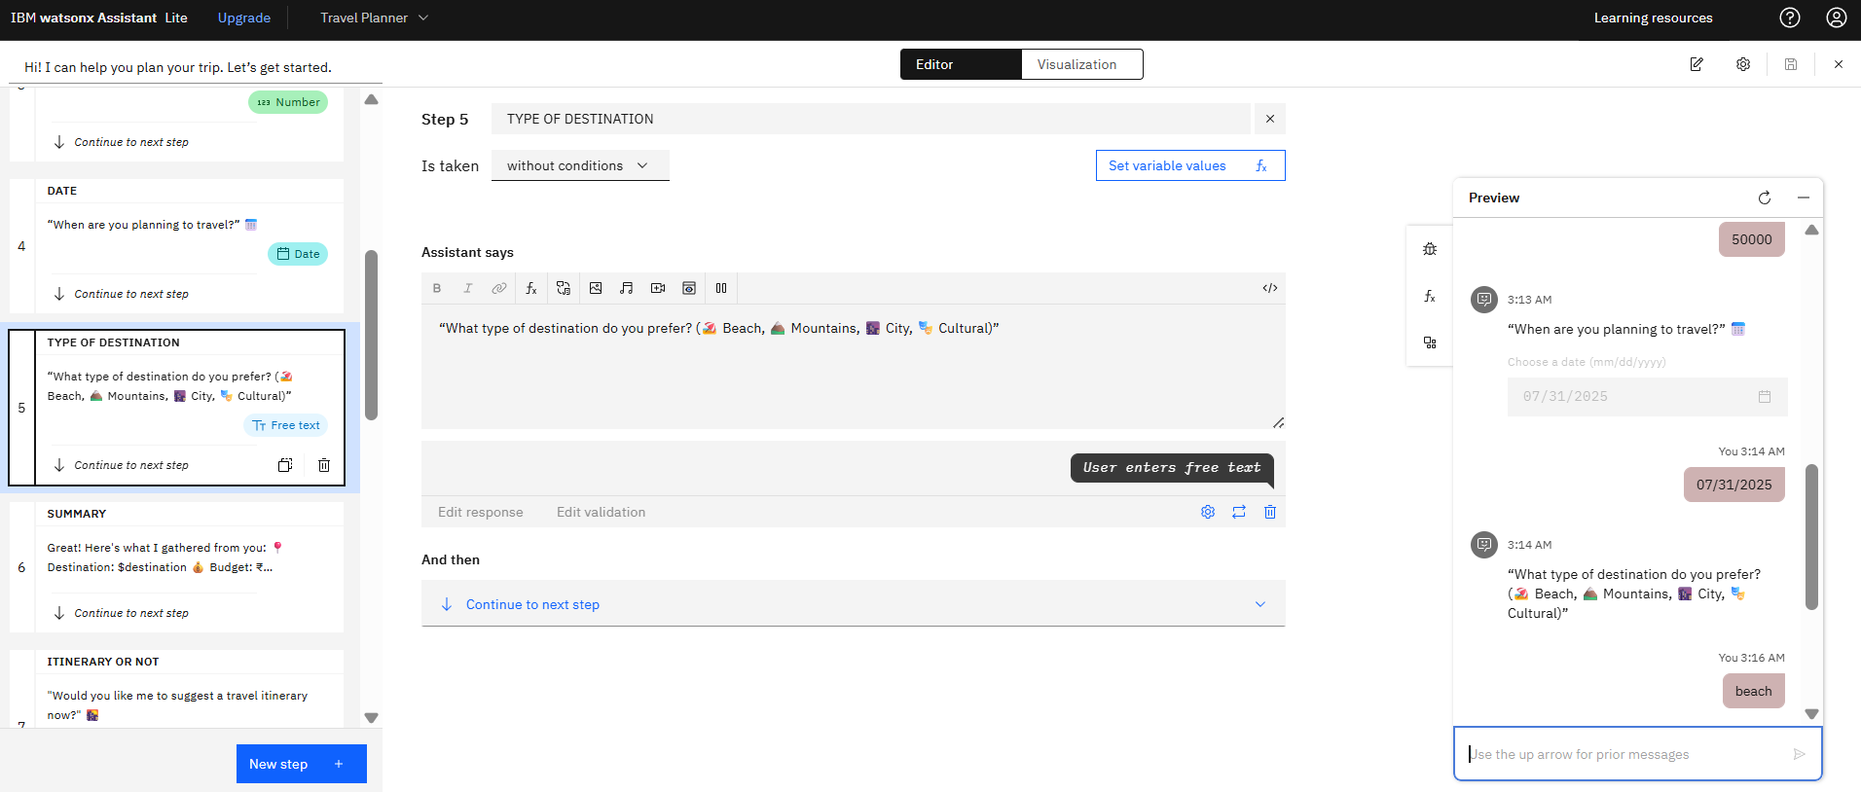
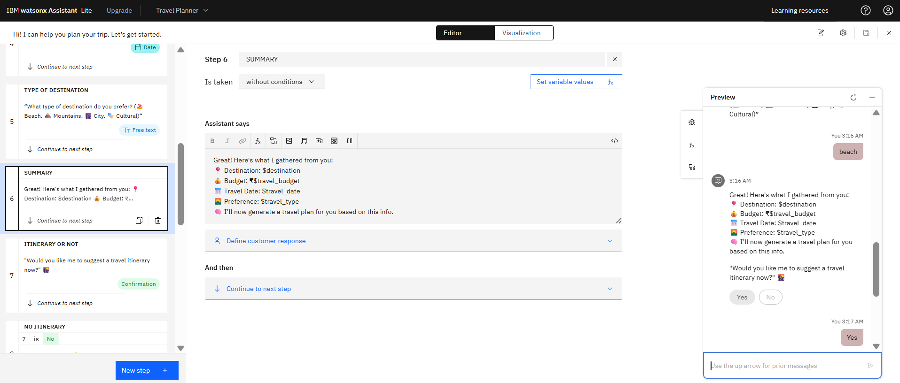
STEP-6 TYPE OF DESTINATION “What type of destination do you prefer? (🏖️ Beach, 🏔️ Mountains, 🌆 City, 🎭 Cultural)”
STEP-7 SUMMARY
Great! Here's what I gathered from you:📍
Destination: $destination 💰
Budget: ₹$travel_budget 📅
Travel Date: $travel_date 🌄
Preference: $travel_type🧠
I’ll now generate a travel plan for you based on this info.

Slide 11
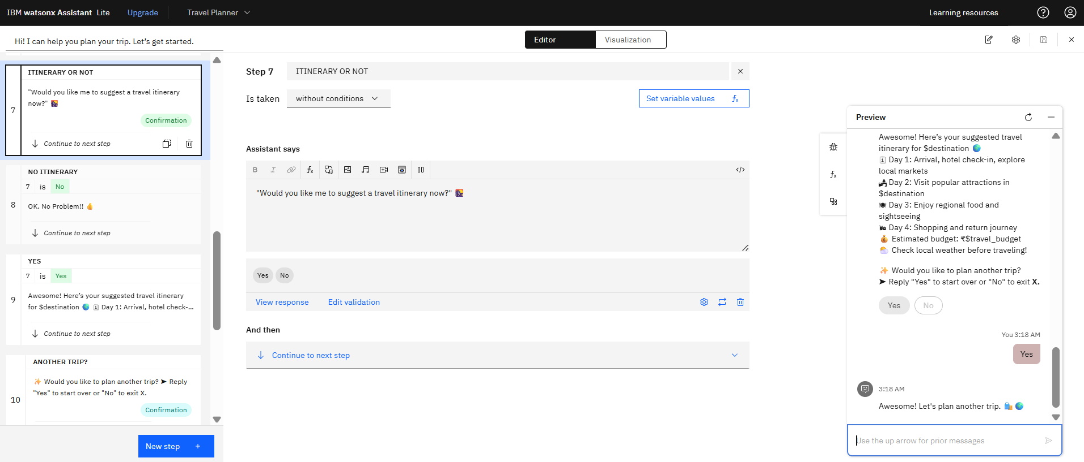
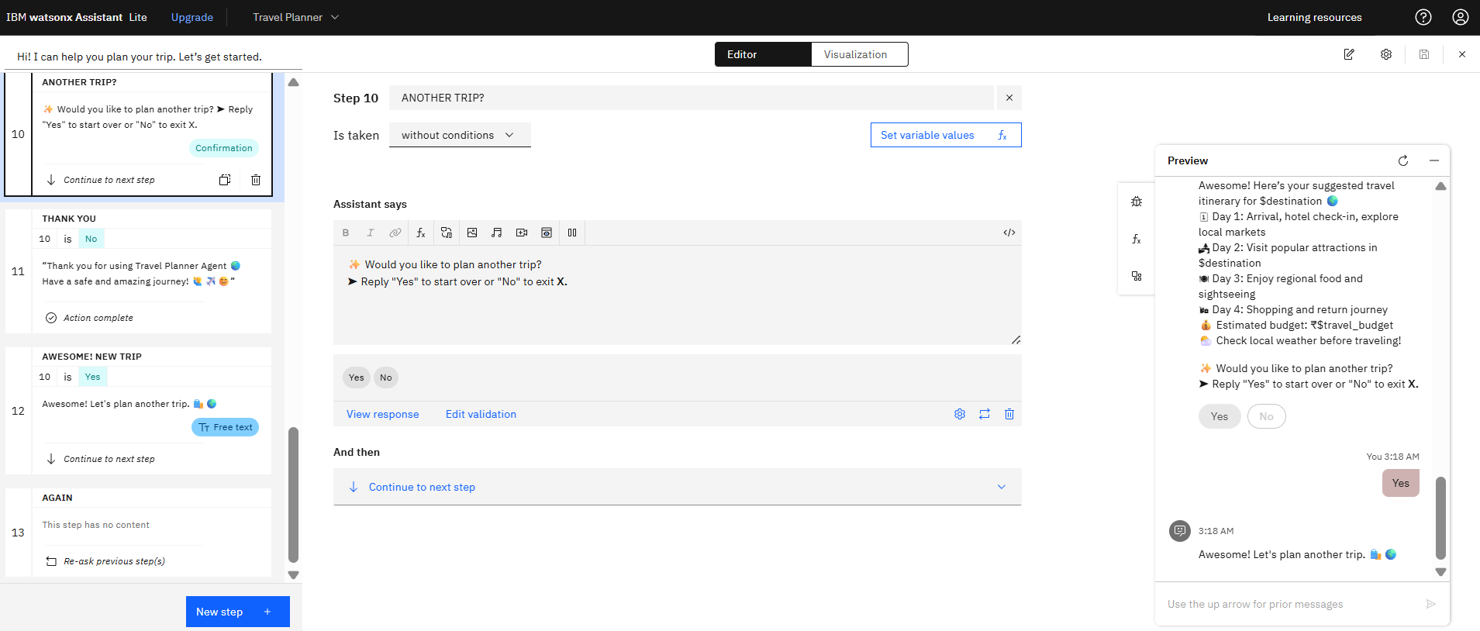
STEP-8 ITINERARY? "Would you like me to suggest a travel itinerary now?" 🌇
NO- OK. No Problem!! 👍
YES- Awesome! Here’s your suggested travel itinerary for $destination 🌍
STEP-9 ANOTHER TRIP? ✨ Would you like to plan another trip? ➤ Reply "Yes" to start over or "No" to exit X.
NO- “Thank you for using Travel Planner Agent 🌏 Have a safe and amazing journey! 🙋‍♂️✈️😊”
YES- Awesome! Let's plan another trip. 🛍️🌍

Slide 12
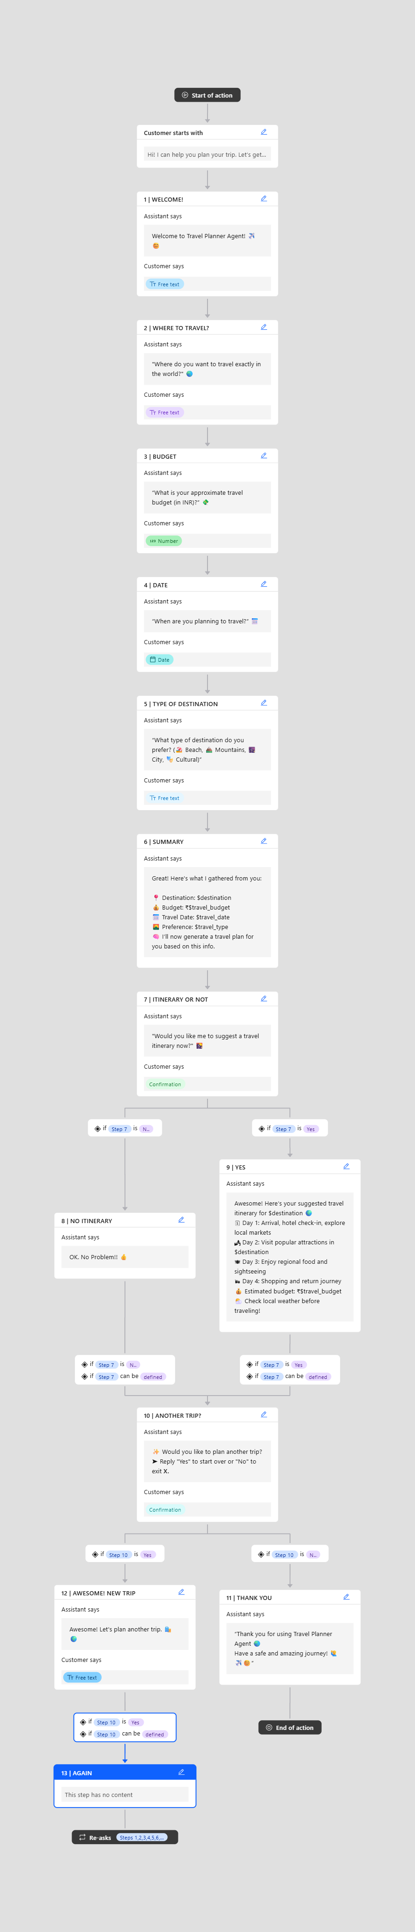
PROJECT FLOWCHART

Slide 13
CONCLUSION
The Travel Planner Agent successfully demonstrates the capability of IBM Watson to build intelligent and user-friendly conversational interfaces. It simplifies trip planning by making it interactive, personalized, and fun. The project effectively combines AI and user experience design.

Slide 14
GITHUB LINK
https://github.com/Sakshamsaxena007/Travel-Planner-Agent.git

Slide 15
FUTURE SCOPE
In the future, the system can be enhanced by:
Connecting live APIs (Weather, Hotels, Flights)
Providing destination recommendations
Including multi-destination planning
Integrating payment gateways for bookings
Expanding language support for global users

Slide 16
REFERENCES
IBM Watson Assistant Documentation
IBM Cloud Portal – https://cloud.ibm.com
Internship Guidelines Document (SB4Academia 2025)
Icons from Emojipedia
Your own code + dialog setup

Slide 17
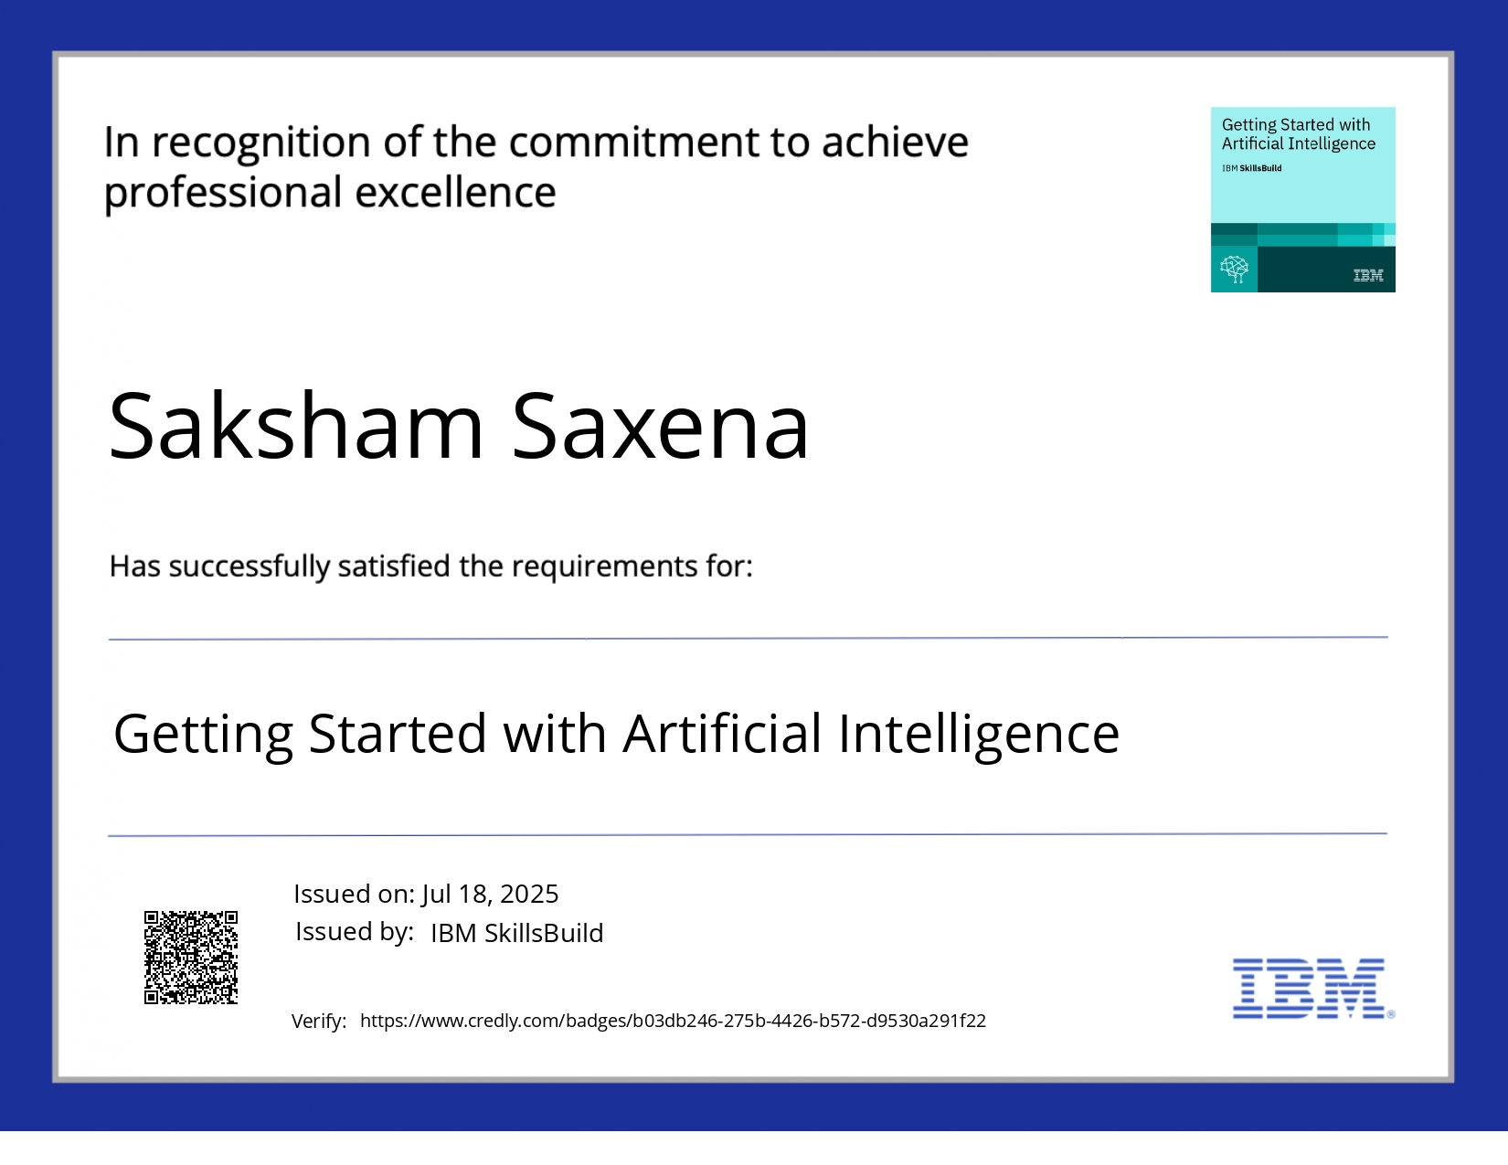
IBM CERTIFICATIONS

Slide 18
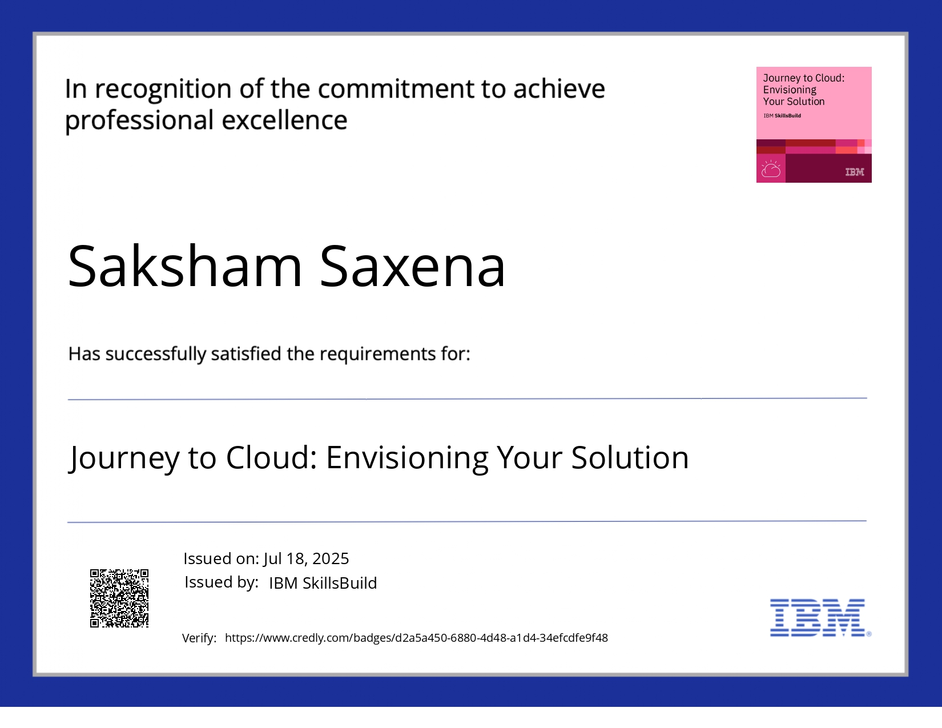
IBM CERTIFICATIONS

Slide 19
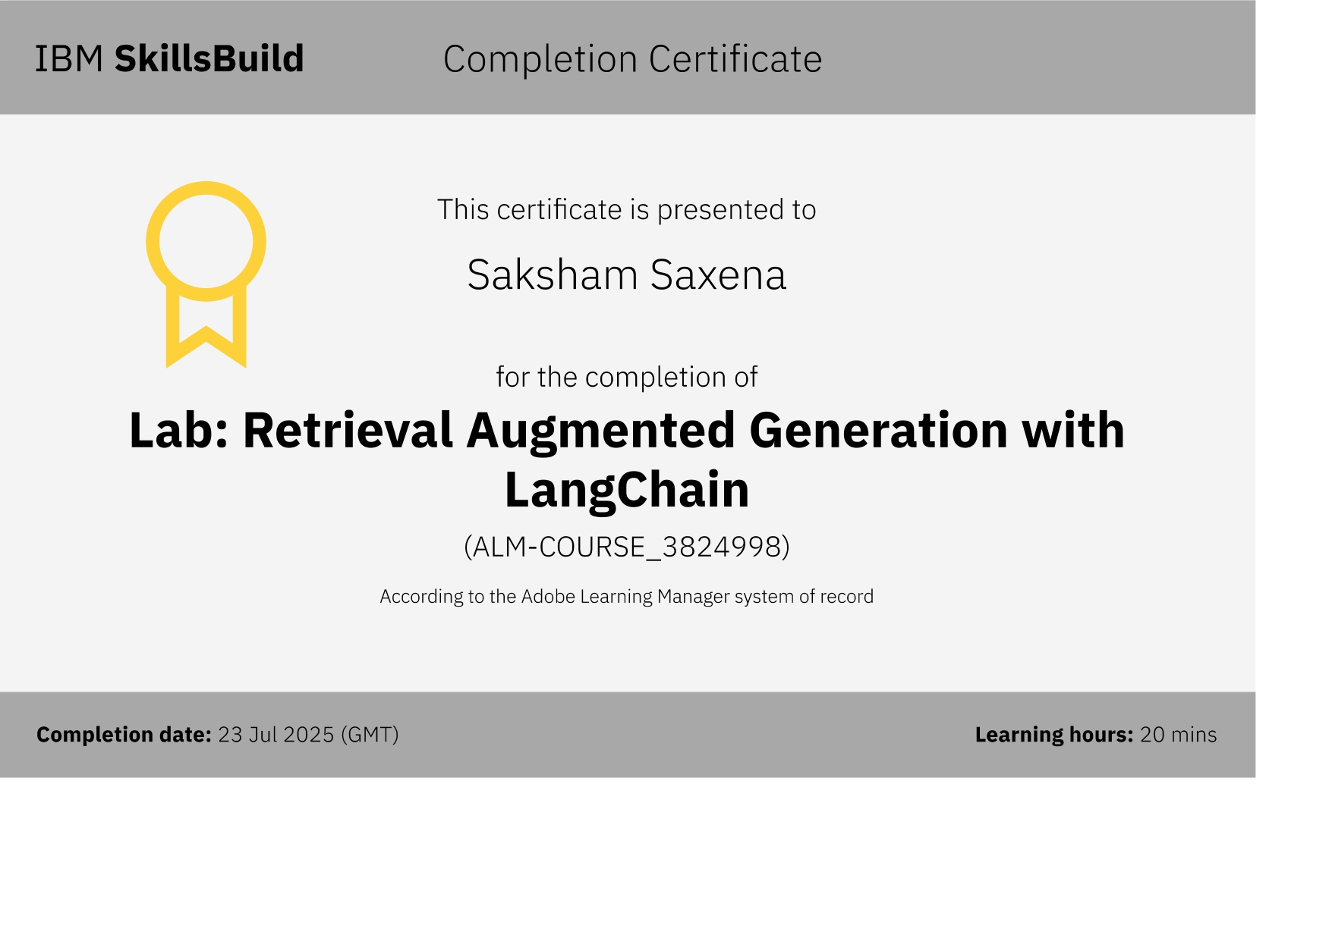
IBM CERTIFICATIONS

Slide 20


